Slide 1

Project Group No: 29
VPKBIET, Baramati
Hand Gesture Controlled Wheelchair With Obstacle Detection
Internet of Things
Rutik Andhalkar [ Exam Seat No-B190353001]
Aavesh Bagwan [ Exam Seat No-B190353006]
Dheeraj Shinde [ Exam Seat No-B190353102]
Prathamesh Shinde [ Exam Seat No-B190353103]
Project Guide: Mr. R.S.Piske

Slide 2
Index
Introduction
Origin of Problem Statement & Motivation
Objective
Literature Review
Methodology
Development Tools
Result
Future Scope
References

Slide 3
Introduction
About 10% of the global population, i.e. about 650 million people, have disabilities and suffering from various challenges in the daily life.
Hence it is extremely essential to build a system for them so that they can move by themselves without need of any other persons helps and live more happily and flexibly and be self dependent for physical movement.
There are varies motion controlled wheelchairs present such as eye movement controlled wheelchair, joystick controlled wheelchair, voice controlled wheel chair, head motion controlled wheelchair, or even wheelchairs which are controlled by brain reading.
But most of them have certain issues, To overcome all that issues we found that using hand gesture controlled wheelchair can be very useful and convenient in all the condition for the operator/ patient.

Slide 4
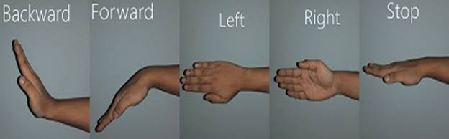
In this by moving wrist of the hand of patient to the right, left, top, down, wheelchair can be moved accordingly to the right, left, forward, and backward respectively

Slide 5
Origin of Problem Statement & Motivation
As we know if a person is physically challenged he or she needs some other person for their mobility and this results in the over dependency of the patient over there companion.
In this fast paced world everyone is busy in its own work due to this there are very few people in the world who can totally be with the patients all time and take care of them in order to bring independence in mobility of the patient we thought to design an automated wheelchair which can be controlled by the patient by itself through his/her hand gestures
In this wheelchair the automation is not isolated as the luxurious thing it is to be beneficial for all common people so, how to reduce the physical strength used by old age and handicapped people to operate the wheelchair is paramount aim.

Slide 6
Objective
Develop a hand gesture controlled wheelchair system that provides physically challenged individuals with a more independent means of mobility.
Design a cost-efficient and userfriendly solution that can be easily adopted by people with disabilities, without requiring extensive training or assistance.
Reduce the physical efforts required by disabled individuals in controlling their wheelchair, enabling them to move around more easily and comfortably.
Incorporate obstacle detection capabilities into the system, enhancing safety and reducing the risk of accidents.

Slide 7
Literature Review
Sr. No | Research Paper Title and Publication Details | Authors | Methodology
1 | “Hand Gesture Controlled Wheelchair” IRJET International Research Journal of Engineeirng and technology Volume -07 Issue- 07 July 2020. | Krunal Bansod, kushal Asarkar, Mandar topre, vikrant raj | Along with all the transmitter and receiver circuit, they have implemented emergency switch with ultrasonic sensor as well.
2 | Design of a low cost hand gesture controlled automated wheelchair.” IEEE Region 10 Symposium, june 2020 | Mufrath, Mahmood, Md.Fahim Rizwan, Masuma Sultana | MPU6050 as sensor at the transmitter along with GPS enabled feature
3 | “Hand Gesture Wheelchair Control Using Raspberry pi”. International Journal of Scientific & Technology Research Volume-09, Issue-04, April 2020 | K.S Vairavel, R.Nevetha | The authors address the limitations of conventional wheelchair control methods and propose a system that utilizes hand gestures for improved mobility. They use a Raspberry Pi microcontroller along with a camera to capture and interpret the hand gestures made by the user.

Slide 8
Sr. No | Research Paper Title and Publication Details | Authors | Methodology
4. | “Wireless Head Gesture Controlled Wheelchair for Disabled Person”. IEEE humanitarian technology conference, December 2017 | Shayban Nasif, Muhammed Abdul Goffar khan | Here a system is based on an Arduino microcontroller, and a RF transmitter and Receiver is used for wireless communication. The user’s head gestures are captured by an accelerometer and gyroscope, and the wheelchair is controlled accordingly.
5. | “Hand gesture controlled wheelchair” international journal of scientific and technology research volume 5, issue 04, April 2016. | Pushpendra jha. | He had used an ADXL335 as accelerometer sensor which will be giving analog signal on moving it in X, Y, Z axis respectively. An LM324 operational amplifier is used as a comparator to convert the analog signal into the digital signal.

Slide 9
Sr. No | Research Paper Title and Publication Details | Authors | Methodology
6. | “Voice and Gesture Based Wheelchair for Physically Challenged Using AVR and Android”. International Research Journal of Engineering and Technology, Volume-03, Issue-04, April 2016. | Revati A. Solanke1, Arti R. Salunke | The authors address the need for an intuitive and user-friendly control mechanism for physically challenged individuals and propose a solution that allows wheelchair control through voice commands and hand gestures.
7. | “Hand Gesture Based Wheelchair Movement Control for Disabled person Using MEMS”. Et al int. Journal of Engineering Research and application , 2014 | Prof Vishal V. Pande | At the transmitter circuit they have used MEMS Accelerometer sensor to sense the hand motion and and uses H Bridge driver at the receiver to control the movement of the motor

Slide 10
Methodology
For the implementation of the project, which is hand gesture controlled wheelchair with obstacle detection we need to make two circuits one for the capturing gesture of the hand made by operator and other for the movement of the wheelchair
According to that gestures and we need to establish a wireless communication between these two circuit for transferring signals from hand gesture capturing circuits to wheelchair moving circuit.

Slide 11
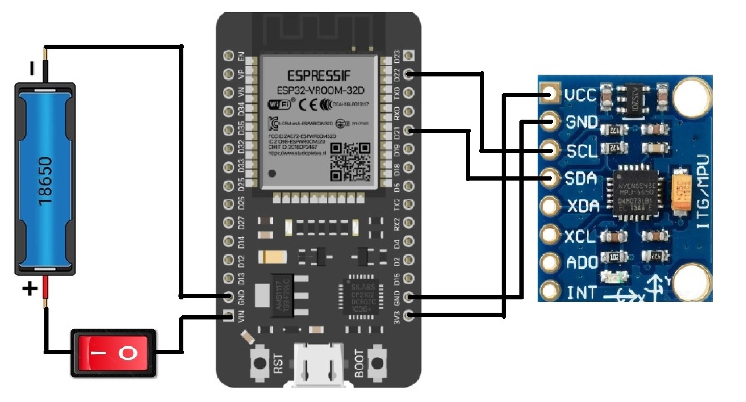
Gesture Recognition Circuit
This is a gesture recognition circuit which deals with the detecting gestures of the hand and then this circuit send commands to the wheelchair moving circuit.
Here, we need a sensor or a mechanism which can detect the gestures of the hand for that purpose we are using accelerometer sensor which deals with the measurements of the change in acceleration due to gravity done by itself.
So if we put this on the hand of the operator we can easily detect the hand motion by measuring change in acceleration due to gravity made by itself.

Slide 12
Here we are using MPU6050 sensor as accelerometer sensor and we are communicating with this via inter-integrated communication protocol
For the wireless communication we are using ESPNOW protocol developed by espressif systems which is a fast communication protocol that can be used to exchange small messages (up to 250 bytes) between ESP32 boards.
ESP-NOW is very versatile and we can have one-way or two-way communication in different setups

Slide 13
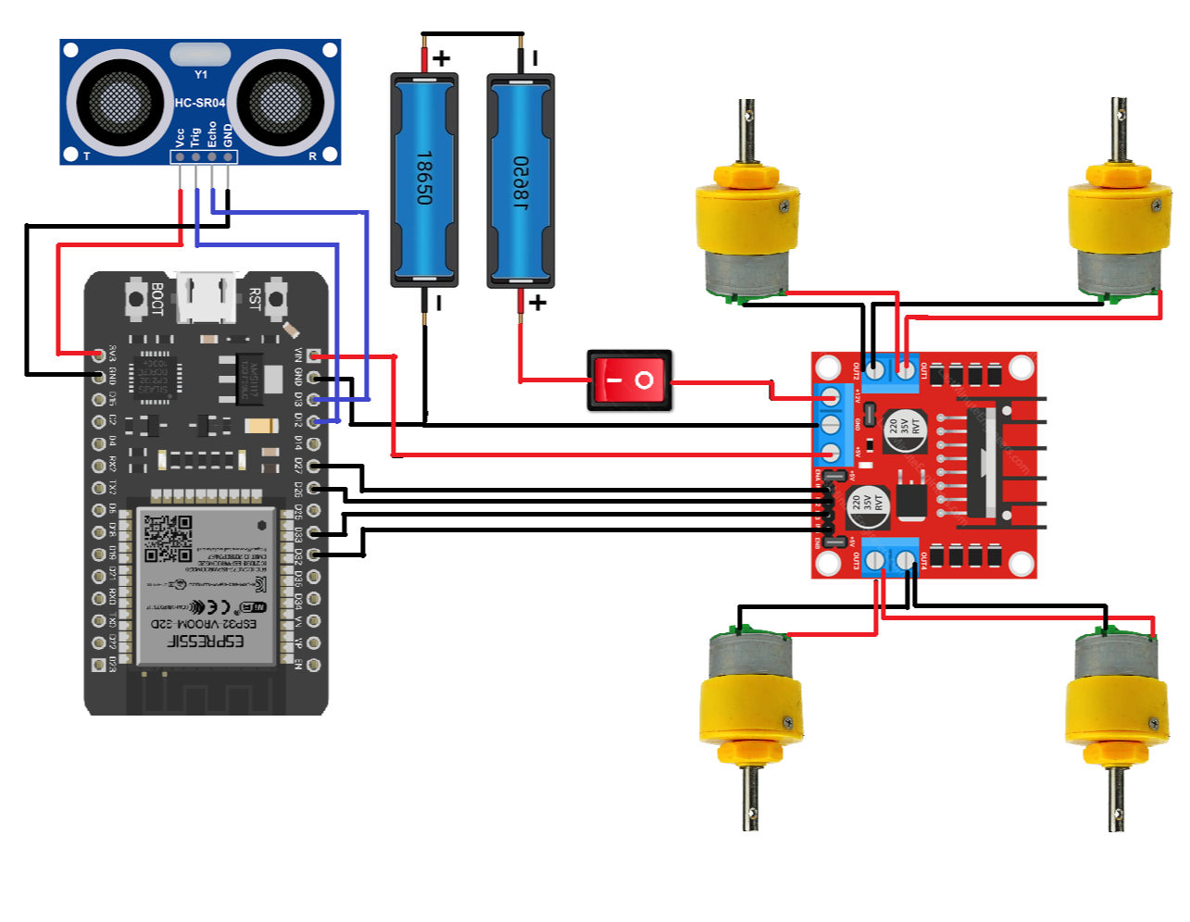
Wheelchair Moving Circuit
This section will respond to the signals received from the gesture recognition circuit.
Here for the processing of the data and controlling of the motors where we need to move wheelchair both forward, backward, right and left for that we need motor controlling operation and for that we are using ESP32 microcontroller board.

Slide 14
We need a motor for movement of the wheelchair for this project purpose we are using dc geared motors this kind of motors have high torque and low RPM which make them suitable for this application.
here we also need a driver circuit which helps us in controlling the direction and speed of the rotation of motors for this we are using H-bridge motor driver which is L298N motor driver which can supply maximum of 2 amps of current and 40v of the voltage at the output on each side.
In order to implement obstacle detection we are using ultrasonic sensor which uses ultrasonic waves for the detection of the obstacle.

Slide 15
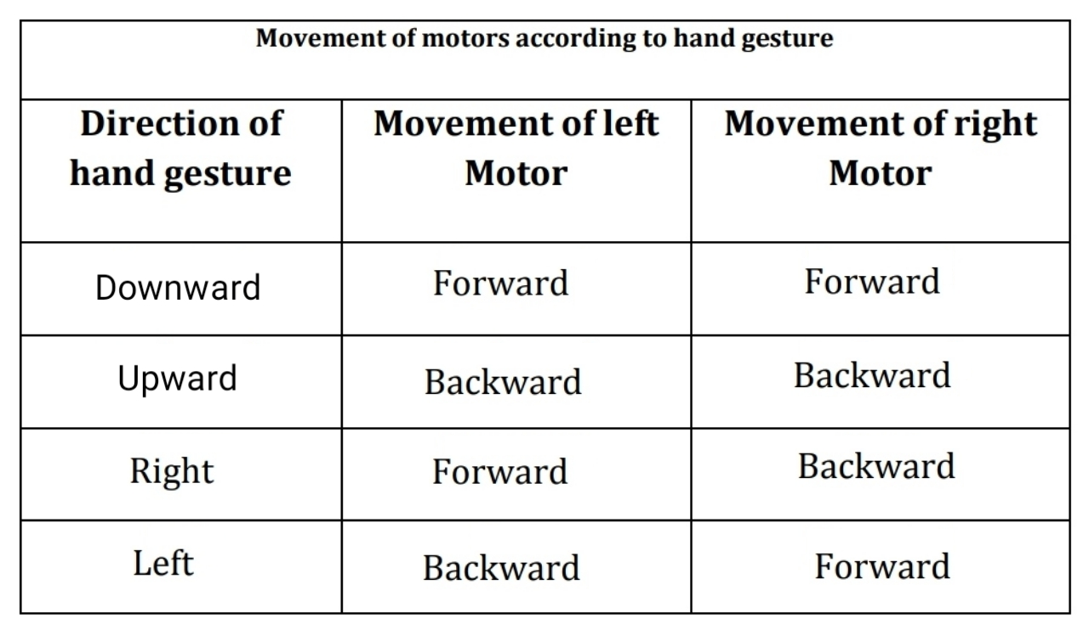
In order to move a chair we are using differential steering mechanism where turning of the chair can be accomplished by changing the direction of the rotation of the motors.

Slide 16
Development Tools
Software
Arduino IDE
Hardware
ESP32
Accelerometer sensor
DC geared Motor
Motor Driver
Lithium-Ion Batteries
Ultrasonic sensor
TP4056 charging module

Slide 17
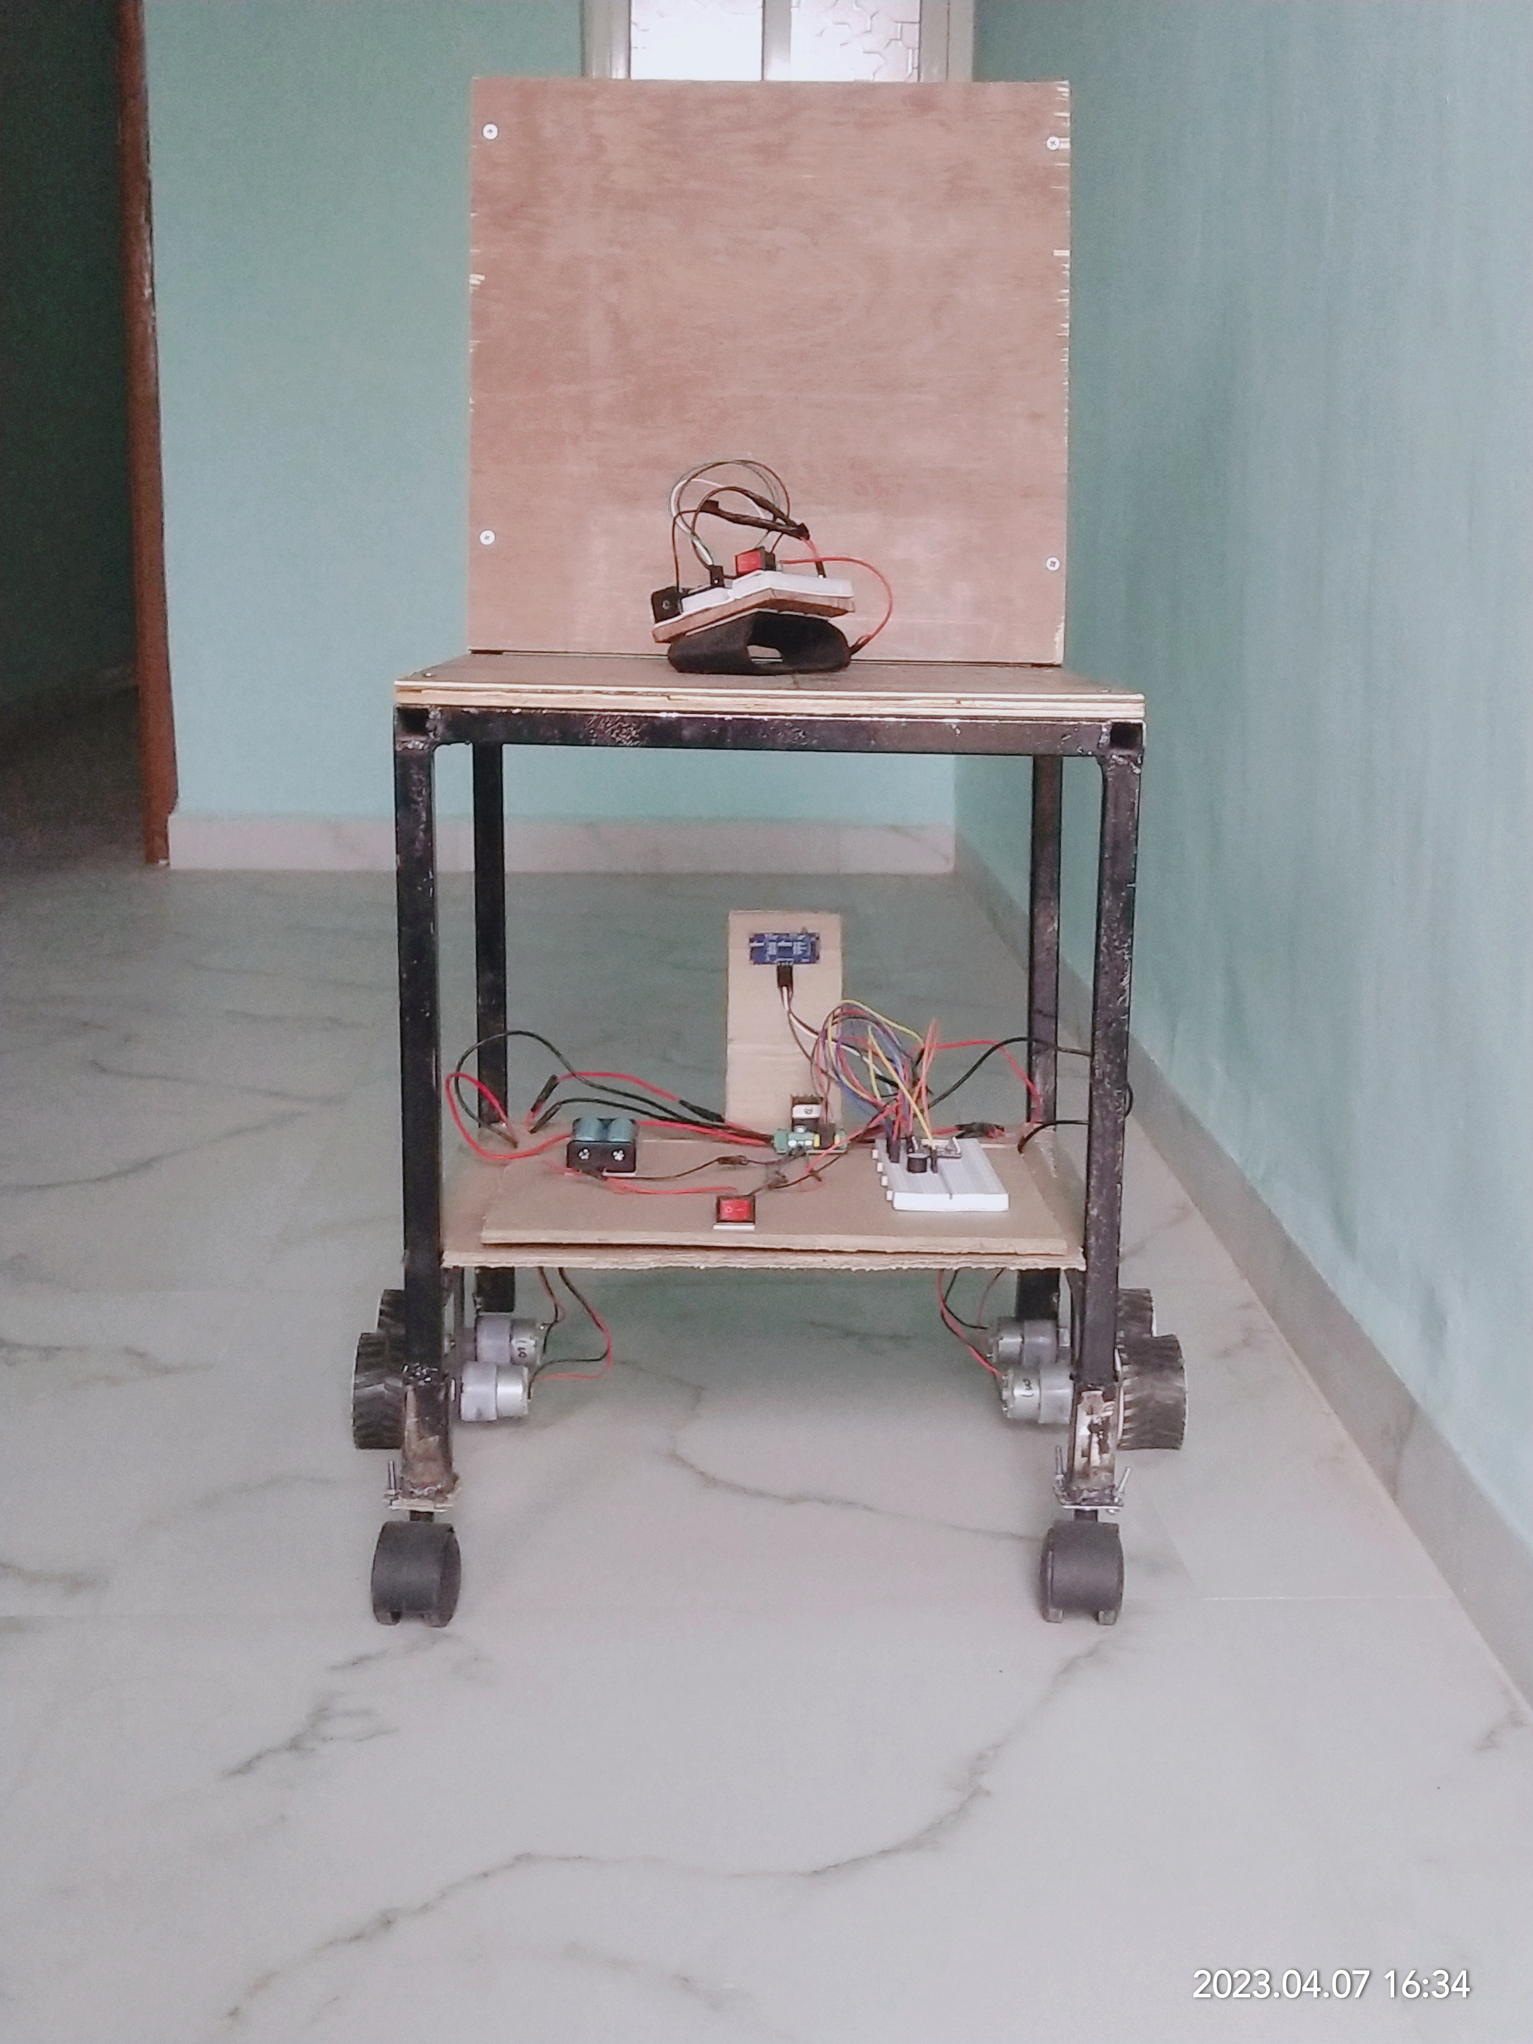
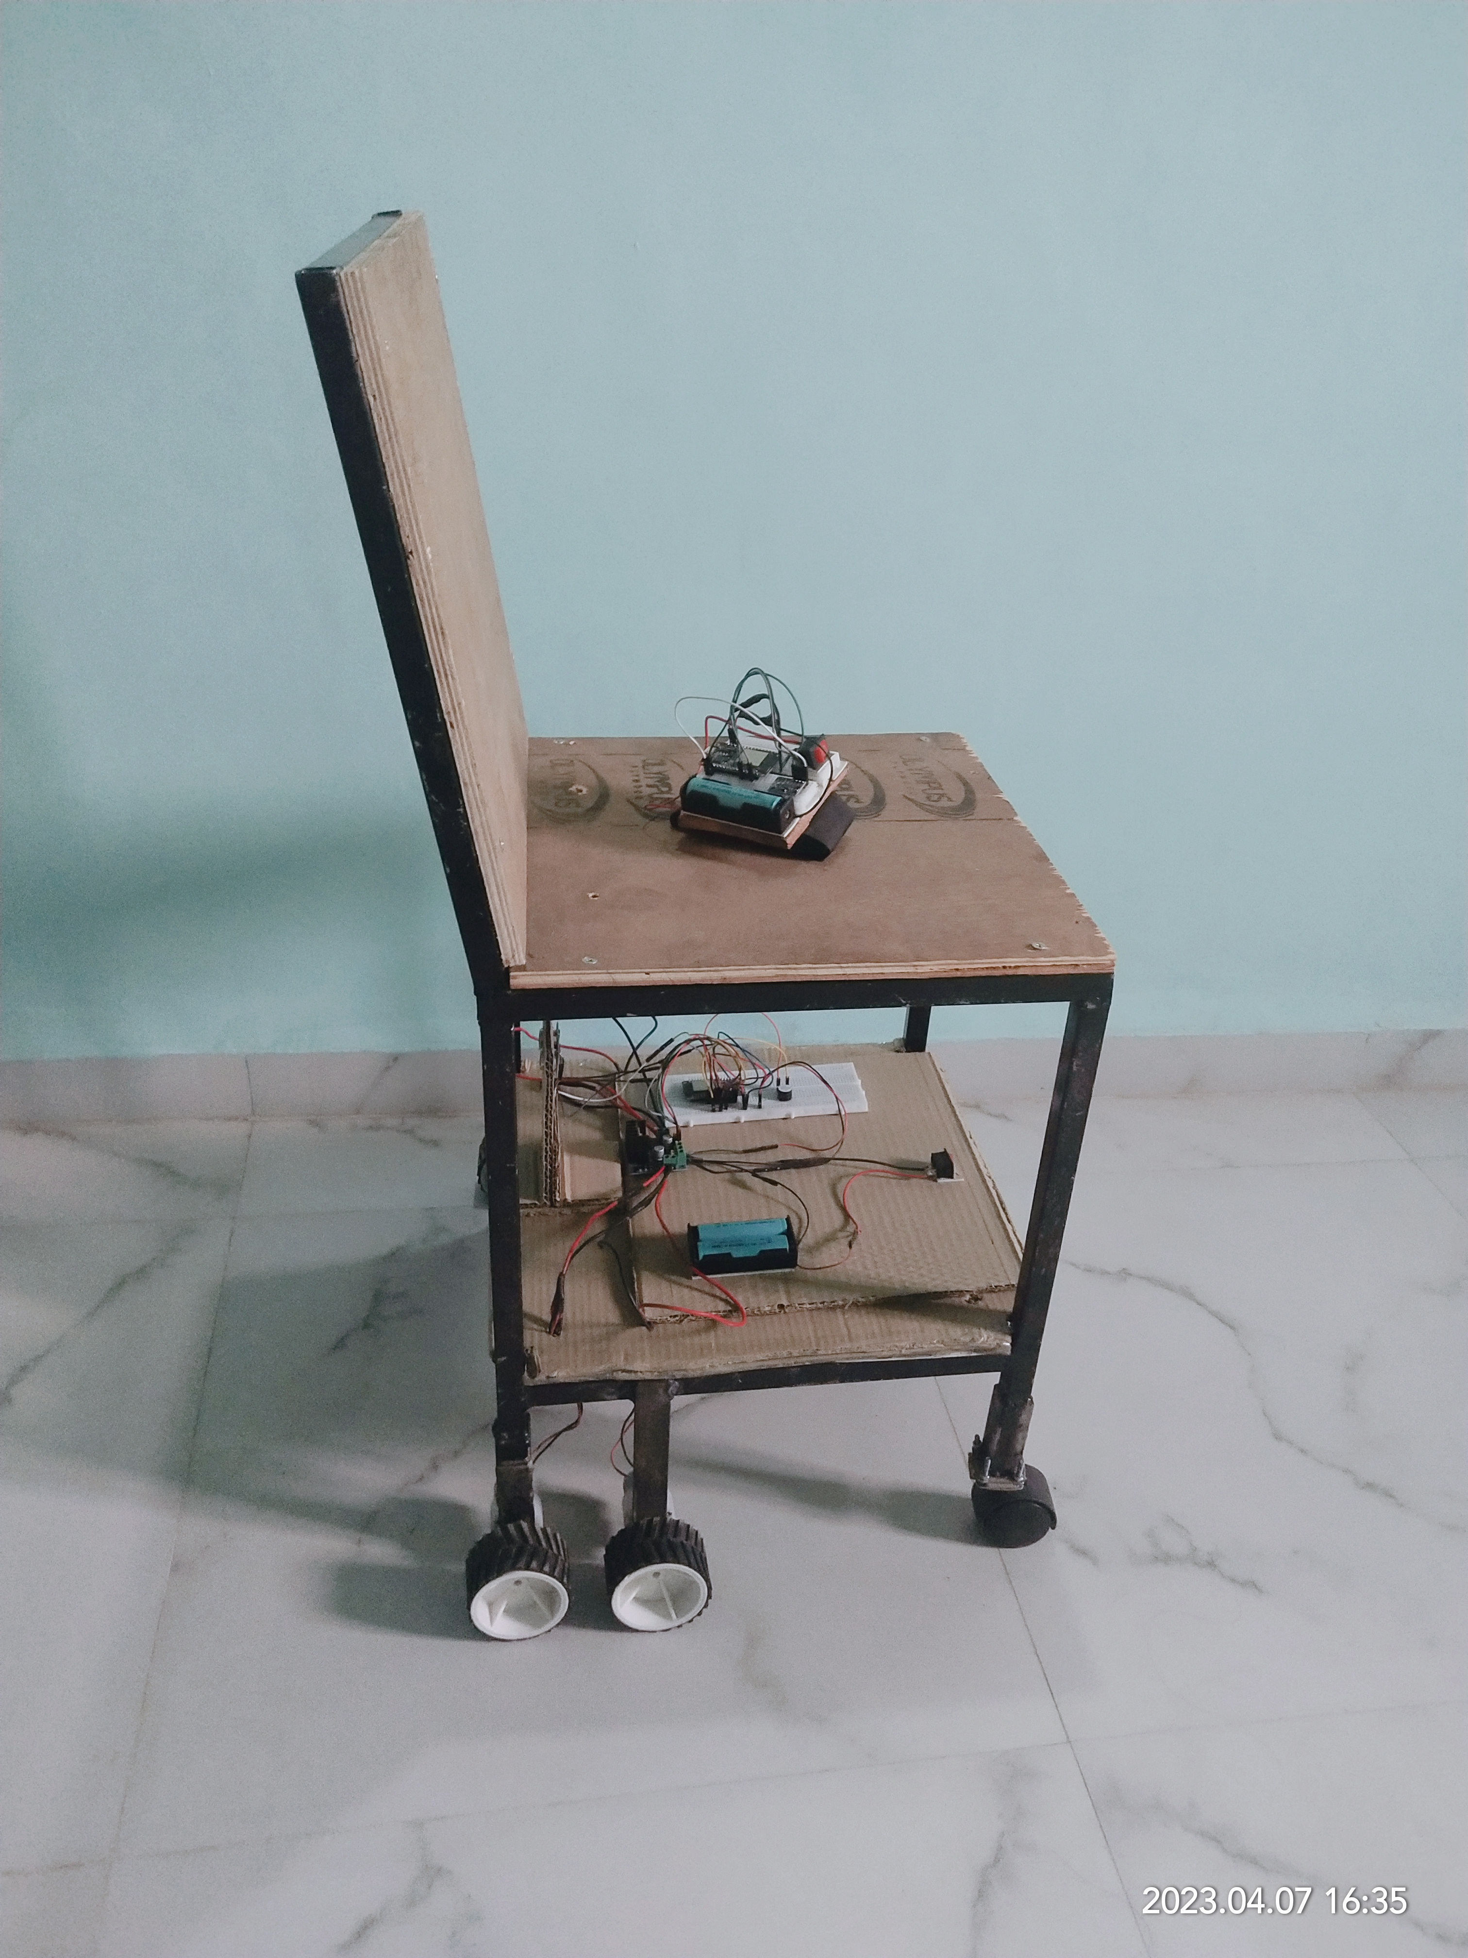
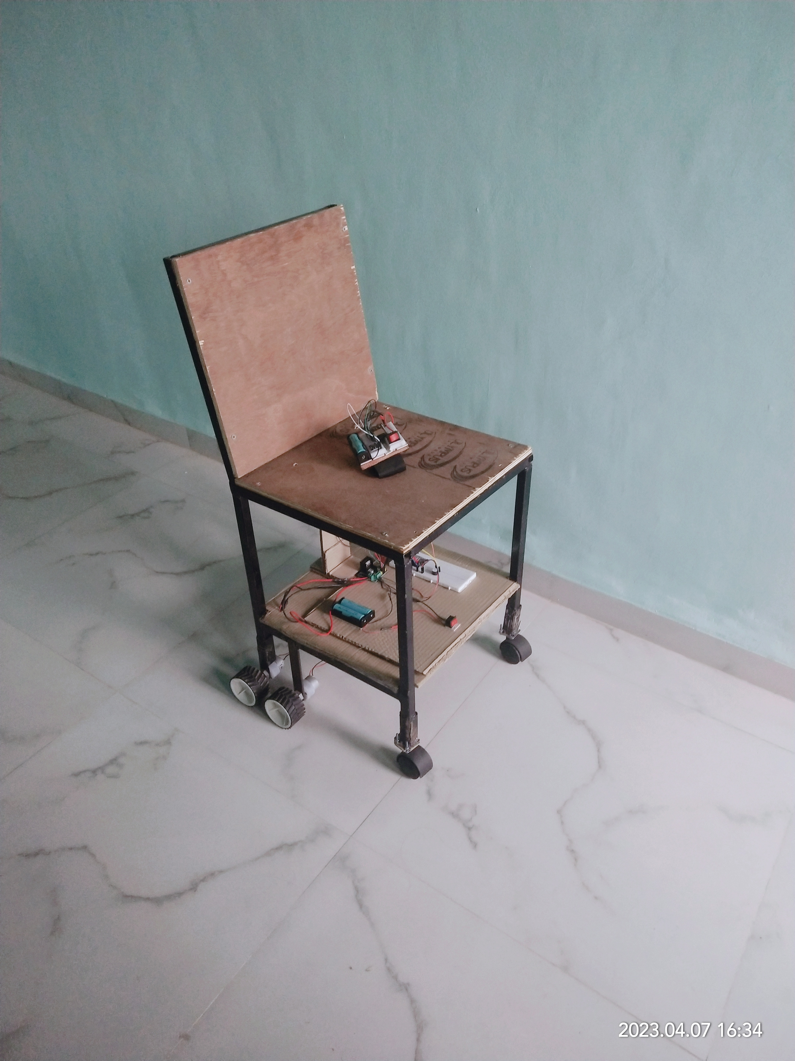
Result

Slide 18
Future Scope
Further by upgrading a motors, motor driver, batteries and structure of wheelchair, we can make this wheelchair capable of carrying human weight.
we can add different functionalities to improve the quality of chair such as emergency messaging system using GSM module, location identification using GPS module.

Slide 19
References
[1] Krunal Bansod, kushal Asarkar, Mandar topre, vikrant raj “Hand Gesture Controlled Wheelchair” International Research Journal of Engineeirng and Technology Volume-07, Issue-07, July 2020.
[2] Mufrath Mahmood, Md. Fahim Rizwan, Masuma Sultana, Md. Habib, Mohammad Hasan Imam. “Design of a low cost Hand Gesture Controlled Automated Wheelchair” IEEE Region 10 Symposium, June 2020.
[3] K.S Vairavel, R.Nevetha, “Hand Gesture Wheelchair Control Using Raspberry pi”. International Journal of Scientific & Technology Research Volume-09, Issue-04, April 2020.
[4] Shayban Nasif, Muhammed Abdul Goffar khan “Wireless Head Gesture Controlled Wheelchair for Disabled Person”. IEEE humanitarian technology conference, December 2017.
[5] Pushpendra jha, “Hand Gesture Controlled Wheelchair”. International Journal of Scientific and Technology Research Volume-05, Issue-04, April 2016.
[6] Revati A. Solanke1, Arti R. Salunke, “Voice and Gesture Based Wheelchair for Physically Challenged Using AVR and Android”. International Research Journal of Engineering and Technology, Volume-03, Issue-04, April 2016.
[7] Prof. Vishal V. Pande, Nikita S. Ubale, Darshana P. Masurkar, Nikita R. Ingole, Pragati P. Mane. “Hand Gesture Based Wheelchair Movement Control for Disabled person Using MEMS”. International Journal of Engineering Research and application Volume-04, issue-04. April 2014.

Slide 20
Thank you

